Slide 1
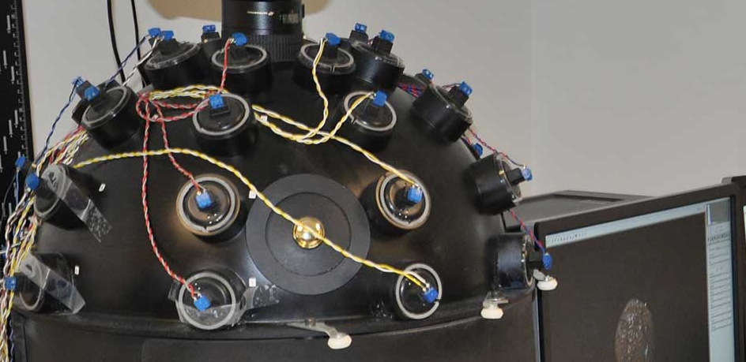
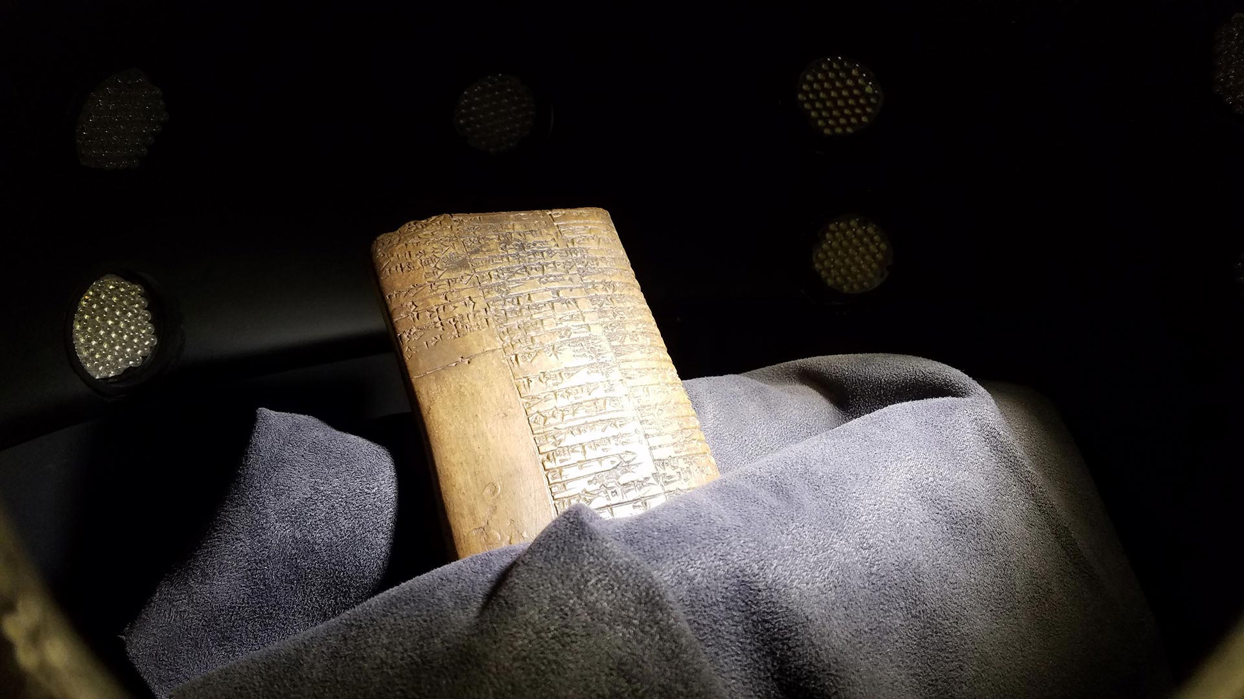
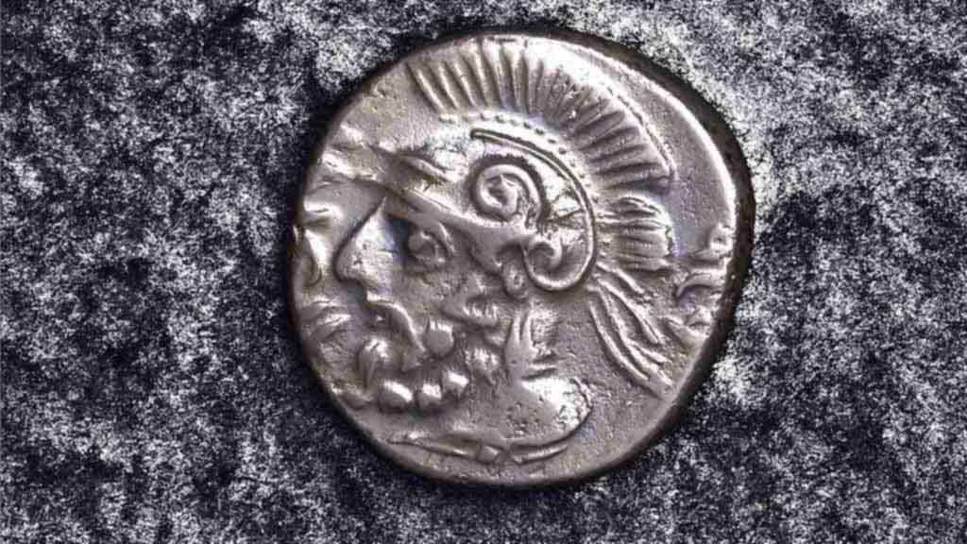
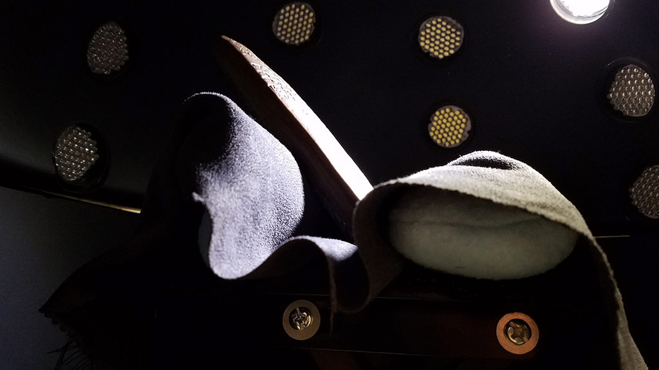
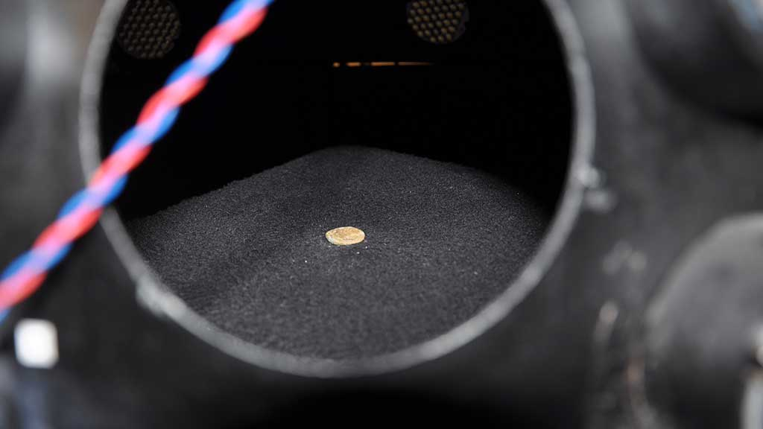
Essential Updates Needed
Help us digitally preserve the Past

Slide 2
Project Design Requirements
We need your help to:
Rewire our dome so that its system and 32 lights are functional again
Do so in a way that optimally fits the designated space and is robust and accessible
Create a software program and control box that that can be easily run on any OS:
It needs to be able to run the lights in sequence from 1-32 synced to our camera's shutter being triggered to fire when each next light turns on
It also needs to be able to independently turn on/off any light(s) in that sequence
We will:
Give you access to the dome and the dedicated museum space we have for it
Meet regularly with you to provide timely assistance and support
Work with you to ensure the project's successful completion by the semester deadline —
A functioning dome that allows us to continue crucial work and you a great capstone project!

Slide 3
What are PTMs and why are they important?
Spurlock Museum has been digitally preserving and sharing PTMs of our artifacts with scholars worldwide since 2008.
PTM (Polynomial Texture Mapping) is a type of photography where a series of images are taken of an artifact, each with a different light angle.
These photographs are then combined into a single 3-D image.
PTMs can then be shared with anyone needing to study an artifact.
This saves on travel costs and avoids needing to physically handle the object to examine it.
It also allows the scholar to zoom in and examine artifacts with any number of lights or lighting angles needed to see key details that might not be possible in person—all in the comfort of their own home and whenever they need to.

Slide 4
What is the issue and how can a Senior Capstone Design Project solve it?
We need your help:
The technology was developed by HP back in 2001 and no longer functions on modern computers.
We need a new controller and updated software to enable us to breathe new life into our PTM Dome to continue our digital artifact preservation efforts.
The lighting needs rewired to be robust to work for a long time.
The new controller needs to be accessible for troubleshooting and repair.

Slide 5
What currently exists?
If you select this project, we will provide you with:
Any specs you need, such as for:
The Canon EOS-1DS Mark-III camera and its stand
The 32 LEDs and wiring
The previous software and control box
Our current PTM Dome
All documentation from previous efforts to update and fix the dome
Any assistance and museum access you need to complete the project

